Slide 1
HOW IS STRATEGIC FIT ACHIEVED?

Slide 2
What does a company want to do to achieve that all-important strategic fit between the supply chain and competitive strategies?
competitive strategy will specify, either explicitly or implicitly, one or more customer segments that a company hopes to satisfy.
To achieve strategic fit, a company must ensure that its supply chain capabilities support its ability to satisfy the targeted customer segments.

Slide 3
three basic steps to achieving this strategic fit
Understanding the Customer and Supply Chain Uncertainty.
Understanding the Supply Chain Capabilities.
Achieving Strategic Fit.

Slide 4
Understanding the Customer and Supply Chain Uncertainty
A company must understand the customer needs for each targeted segment and the uncertainty the supply chain faces in satisfying these needs.
These needs help the company define the preferred cost and service requirements.
The supply chain uncertainty helps the company identify the amount of the unpredictability of demand, disruption, and delay that the supply chain must be prepared for.

Slide 5
customer demand from different segments varies along several attributes
Quantity of product needed in each lot
Response time customers will tolerate
Variety of products needed
Service level required
Price of the product
Desired rate of innovation in the product

Slide 6
Quantity of product required in each group
An emergency order for material needed to repair a production line is likely to be small.
An order for material to construct a new production line is likely to be large.

Slide 7
The Response Time that Customers are Willing to Tolerate
Response time is simply the time between when a customer inquiry or contact is received and when it is responded to.
The supportable response time for the emergency order is likely to be short, whereas the allowable response time for the construction order is appropriate to be long.

Slide 8
The Variety of Products Needed
A customer may place a high premium on the
availability of all parts of an emergency repair order from a single supplier.
This may not be the case for the construction order.

Slide 9
The Service Level Required
customer placing an emergency order expects a high level of product availability.
This customer may go elsewhere if all parts of the order are not immediately available.
This is not apt to happen in the case of the construction order, for which a long lead time is likely

Slide 10
The Price of the Product
The customer placing the emergency order is apt to be much less sensitive to price than the customer placing the construction order.

Slide 11
The Desired Rate of Innovation in the Product
Customers at a high-end department store expect a lot of innovation and new designs in the store's apparel.

Slide 12
Each customer in a particular segment will tend to have similar needs, whereas customers in a different segment can have very different needs.
described the many attributes along which customer demand varies, our goal is to identify one key measure for combining all of these attributes.
This single measure then helps define what the supply chain should do particularly well.
Many attributes but ideally one overall attribute/key measure of customer’s demand should identified and used: Implied demand uncertainty

Slide 13
Demand Uncertainty
A business has difficulty, accurately projecting customer demand in the future.
This create a significant challenge because it makes inventory hard to control and manage.
Demand uncertainty reflects the uncertainty of customer demand for product

Slide 14
Demand Uncertainty causes
With more serial products where demand vary over time, spikes and dips vary in strength.
Changes in customer interests and needs, technology development and the number of competitors you face can all impact your demand as well.
These factors may lead to increases in buying relative to expectations or declines in buying relative to your forecasts.

Slide 15
Demand uncertainty problems
Demand uncertainty creates a burden for your business.
Goals of inventory management usually include minimizing stock-outs while avoiding the high cost of holding excess inventory.
When you can't accurately predict demand, you run risks of one of these happening.
You may over-buy inventory to protect against running out. This leads to the need to store extra products, offer discounts or throw out excess.
If you buy less to prevent waste, high demand can lead to stock-outs and upset customers.

Slide 16
Implied Demand Uncertainty
Resulting uncertainty for the supply chain given the portion of the demand the supply chain must handle and attributes the customer desires.
Implied demand uncertainty reflects the ability of sc to meet demand, results from the demand uncertainty plus customer needs.

Slide 17
suppose you are stocking iPhone 5s for sale.
You project your sales and then you look at how much of that your supply chain can cover.
Example:- you are in a large metro area and can sell 50,000 iPhone 5s but the very bad supplier will give you only 30,000 iPhone 5s.
That means the maximum number of customers you can handle is 30,000.

Slide 18
Let's say that you do a little looking at trends and such and you determine that 25% of your customers have to upgrade to the iPhone 5 due to work requirements.
75% of your sales will be due to the customer's desire(want to purchase) to have the latest Apple phone.

Slide 19
Your implied demand uncertainty is 75% of 30,000.
if the reviews are bad or the customers decide the iPhone 4 is fine, then you could have (75% of 30,000) iPhone 5s in stock that you can't sell.

Slide 20
Customer Needs and Implied Demand Uncertainty
Customer Need | Causes Implied Demand Uncertainty to …
Range of quantity required increases | Increase because a wider range of the quantity required implies greater variance in demand
Lead time decreases | Increase because there is less time in which to react to orders
Variety of products required increases | Increase because demand per product becomes more disaggregate
Number of channels through which product may be acquired increases | Increase because the total customer demand is now disaggregated over more channels
Rate of innovation increases | Increase because new products tend to have more uncertain demand
Required service level increases | Increase because the firm now has to handle unusual surges in demand

Slide 21
Implied Uncertainty and Other Attributes
 | Low Implied Uncertainty | High Implied Uncertainty
Product margin | Low | High
Average forecast error | 10% | 40% to 100%
Average stock-out rate | 1% to 2% | 10% to 40%
Average forced season-end markdown | 0% | 10% to 25%

Slide 22
Products with undecided order are often less grown-up and have less direct competition.
Forecasting is more accurate when demand has less uncertainty.
Forecasting is the process of making predictions of the future based on past and present data

Slide 23
Increased implied demand uncertainty leads to increased difficulty in matching supply with demand. For a given product, this dynamic can lead to either a stock-out or an oversupply situation.
Markdowns are high for products with greater implied demand uncertainty because oversupply often results.

Slide 24
Supply uncertainty is also strongly affected by the life-cycle position of the product.
New products being introduced have higher supply uncertainty because designs and production processes are still evolving.

Slide 25
Impact of Supply Source Capability
Supply Source Capability | Causes Supply Uncertainty to...
Frequent breakdowns | Increase
Unpredictable and low yields | Increase
Poor quality | Increase
Limited supply capacity | Increase
Inflexible supply capacity | Increase
Evolving production process | Increase

Slide 26
KEY POINT
The first step in achieving strategic fit between competitive and supply chain strategies is to understand customers and supply chain uncertainty.
Uncertainty from the customer and the supply chain can be combined and mapped on the implied uncertainty spectrum.

Slide 27
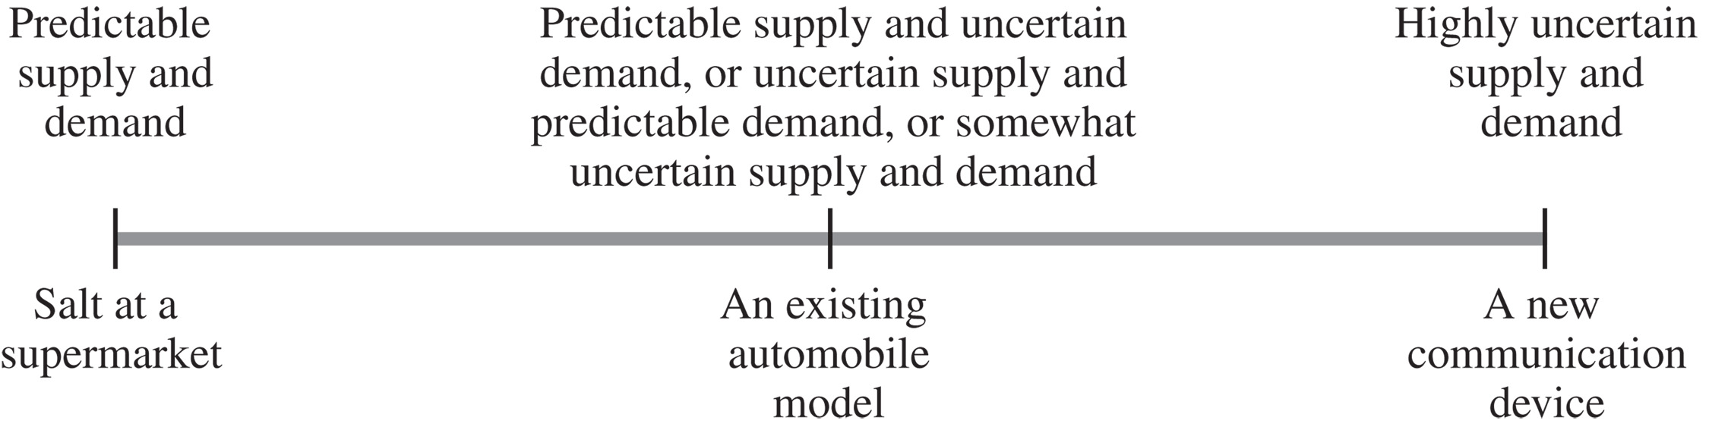

Slide 28
Step 2: Understanding the Supply Chain Capabilities
How does the firm best meet demand in that uncertain environment? Creating strategic fit is all about creating a supply chain strategy that best meets the demand a company has targeted given the uncertainty it faces.

Slide 29
Supply chain responsiveness includes a supply chain's ability to do the following:
• Respond to wide ranges of quantities demanded
• Meet short lead times
• Handle a large variety of products
• Build highly innovative products
• Meet a high service level
• Handle supply uncertainty

Slide 30
Responsiveness, however, comes at a cost.
For instance, to respond to a wider range of quantities demanded, capacity must be increased, which increases costs.

Slide 31
Supply chain efficiency is the inverse of the cost of making and delivering a product to the customer.
Increases in cost lower efficiency. For every strategic choice to increase responsiveness, there are additional costs that lower efficiency.

Slide 32
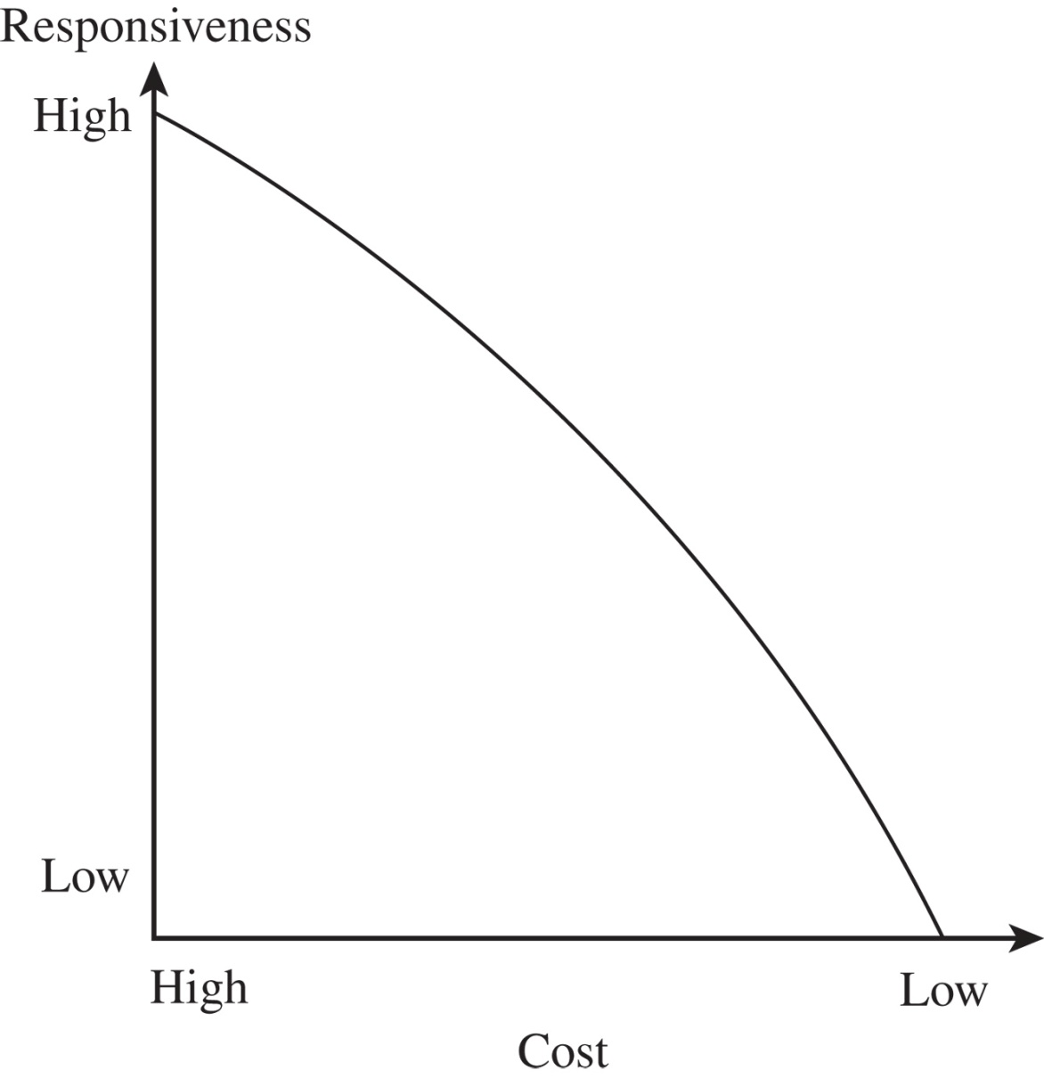
Cost-Responsiveness Efficient Frontier
Figure 2-3

Slide 33
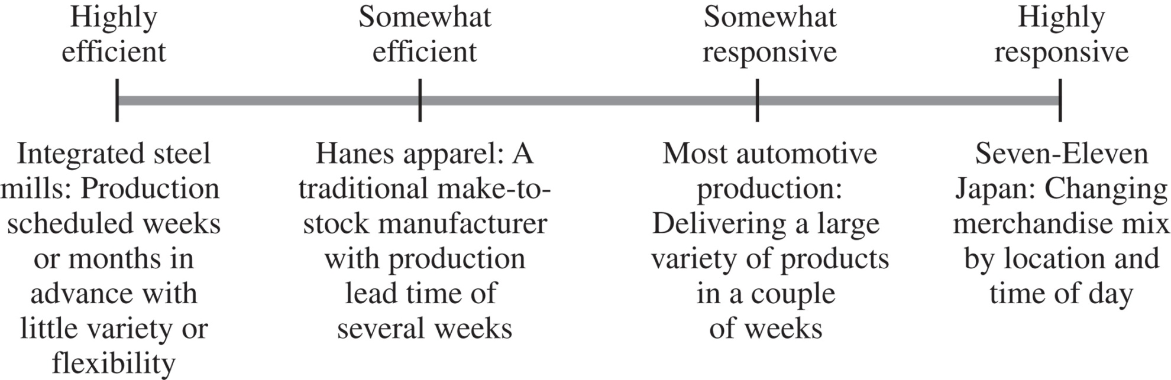
Responsiveness Spectrum
Figure 2-4

Slide 34
KEY POINT
The second step in achieving strategic fit between competitive and supply chain strategies is to understand the supply chain and map it on the responsiveness spectrum.

Slide 35
Step 3: Achieving Strategic Fit
First step in achieving strategic fit is to assign roles to different stages of the supply chain that ensure the appropriate level of responsiveness.
It is important to understand that the desired level of responsiveness required across the supply chain may be attained by assigning different levels of responsiveness and efficiency to each stage of the supply chain.

Slide 36
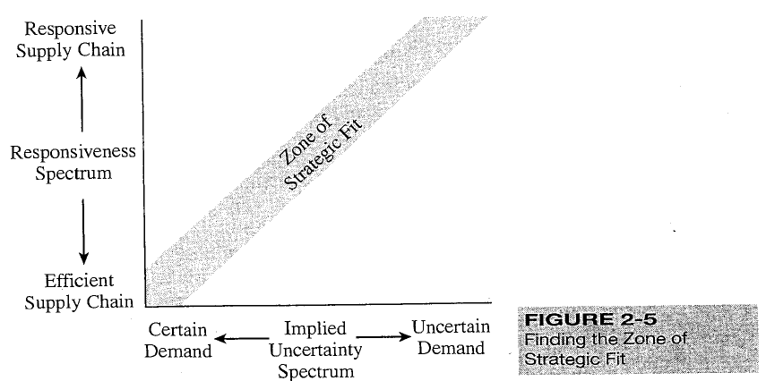

Slide 37
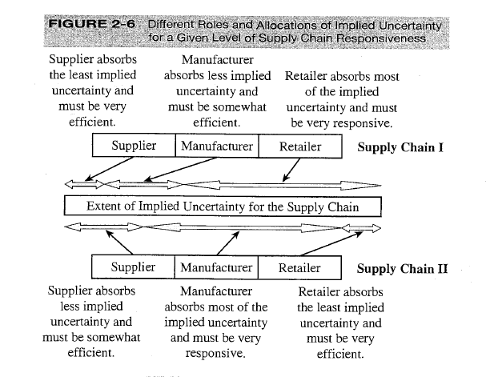

Slide 38
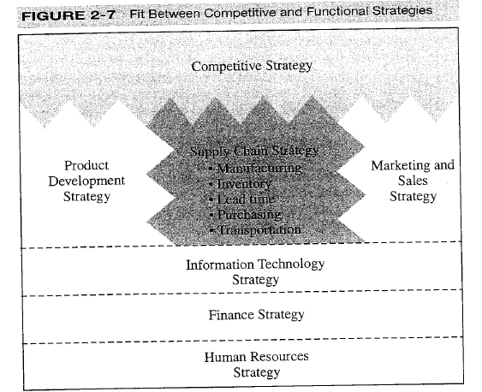
complete strategic fit

Slide 39
A firm must also ensure that all its functions maintain consistent strategies that support the competitive strategy.
All functional strategies must support the goals of the competitive strategy.
All sub-strategies within the supply chain-such as manufacturing, Inventory, and purchasing-must also be consistent with the supply chain's level of responsiveness.

Slide 40
OTHER ISSUES AFFECTING STRATEGIC FIT
Achieving strategic fit when a firm serves a single market segment and the result is a well-defined strategic position.
Consider how multiple products, multiple customer segments, and product life cycle affect strategic fit.
Multiple Products and Customer Segments
Product Life Cycle
Globalization and Competitive Changes over Time

Slide 41
Multiple Products and Customer Segments
Most companies produce and sell multiple products to multiple customer segments, each with different characteristics.

Slide 42
Product Life Cycle
products go through their life cycle, the demand characteristics and the needs of the customer segments being served change.
Supply characteristics also change as the product and production technologies mature.

Slide 43
Globalization and Competitive Changes over Time
A final dimension to consider when matching supply chain and competitive strategy is the change in competitor behavior resulting from changes in the marketplace or increased globalization.

Slide 44
EXPANDING STRATEGIC SCOPE

